Slide 1
AuxIoT Smart Audio proposal

Slide 2
EE Spec.
Key Specifications:
2.4G Wi-Fi 6&BT5.4&SOC combo module:ESP32-S31-WROOM-3-N16R16V(16MB Flash+16MB PSRAM)
Tips:Espressif recommends the ESP32-S31, which is expected to enter mass production around October 2026
LCD driver Espressif ESP32-P4
8.88 inch TFT LCD without touch, Active area:57.72(H) ×218.88(V) mm,resolution:480xRGBx1920( please provide UI)
Quectel EG916Q-GL LTE Cat 1 bis Module, with eSim
inputs & outputs
Wi-Fi &Bluetooth connection(internal RF antenna)
LTE Cat 1 connection(internal RF antenna)
1x 3.5mm Jack for line out( Max. 1Vrms)
1x USB C for 30W PD power charging
1x eSIM
1x 16GB SD card inside(No external SD card slot should be exposed on the product enclosure.)
1x 3.5mm jack for mic input, 1x 6.35mm jack for mic input
Built in 2S1P 21700 Battery pack,7.4V/5000mAh battery with gas gauge(At 50% screen brightness, estimated play time is about 10H in LTE mode)
User interface
1x RGB for Status indication( A non-blinking indication )
5x buttons for power, menu/mode , V+,V-,Mic on/off( no support wake up)
Shunno will handle the app control and cloud.
Accessories
1x USB C to USB C cable, Black, length=2000mm
1x 30W PD AC adapter with EU plug

Slide 3
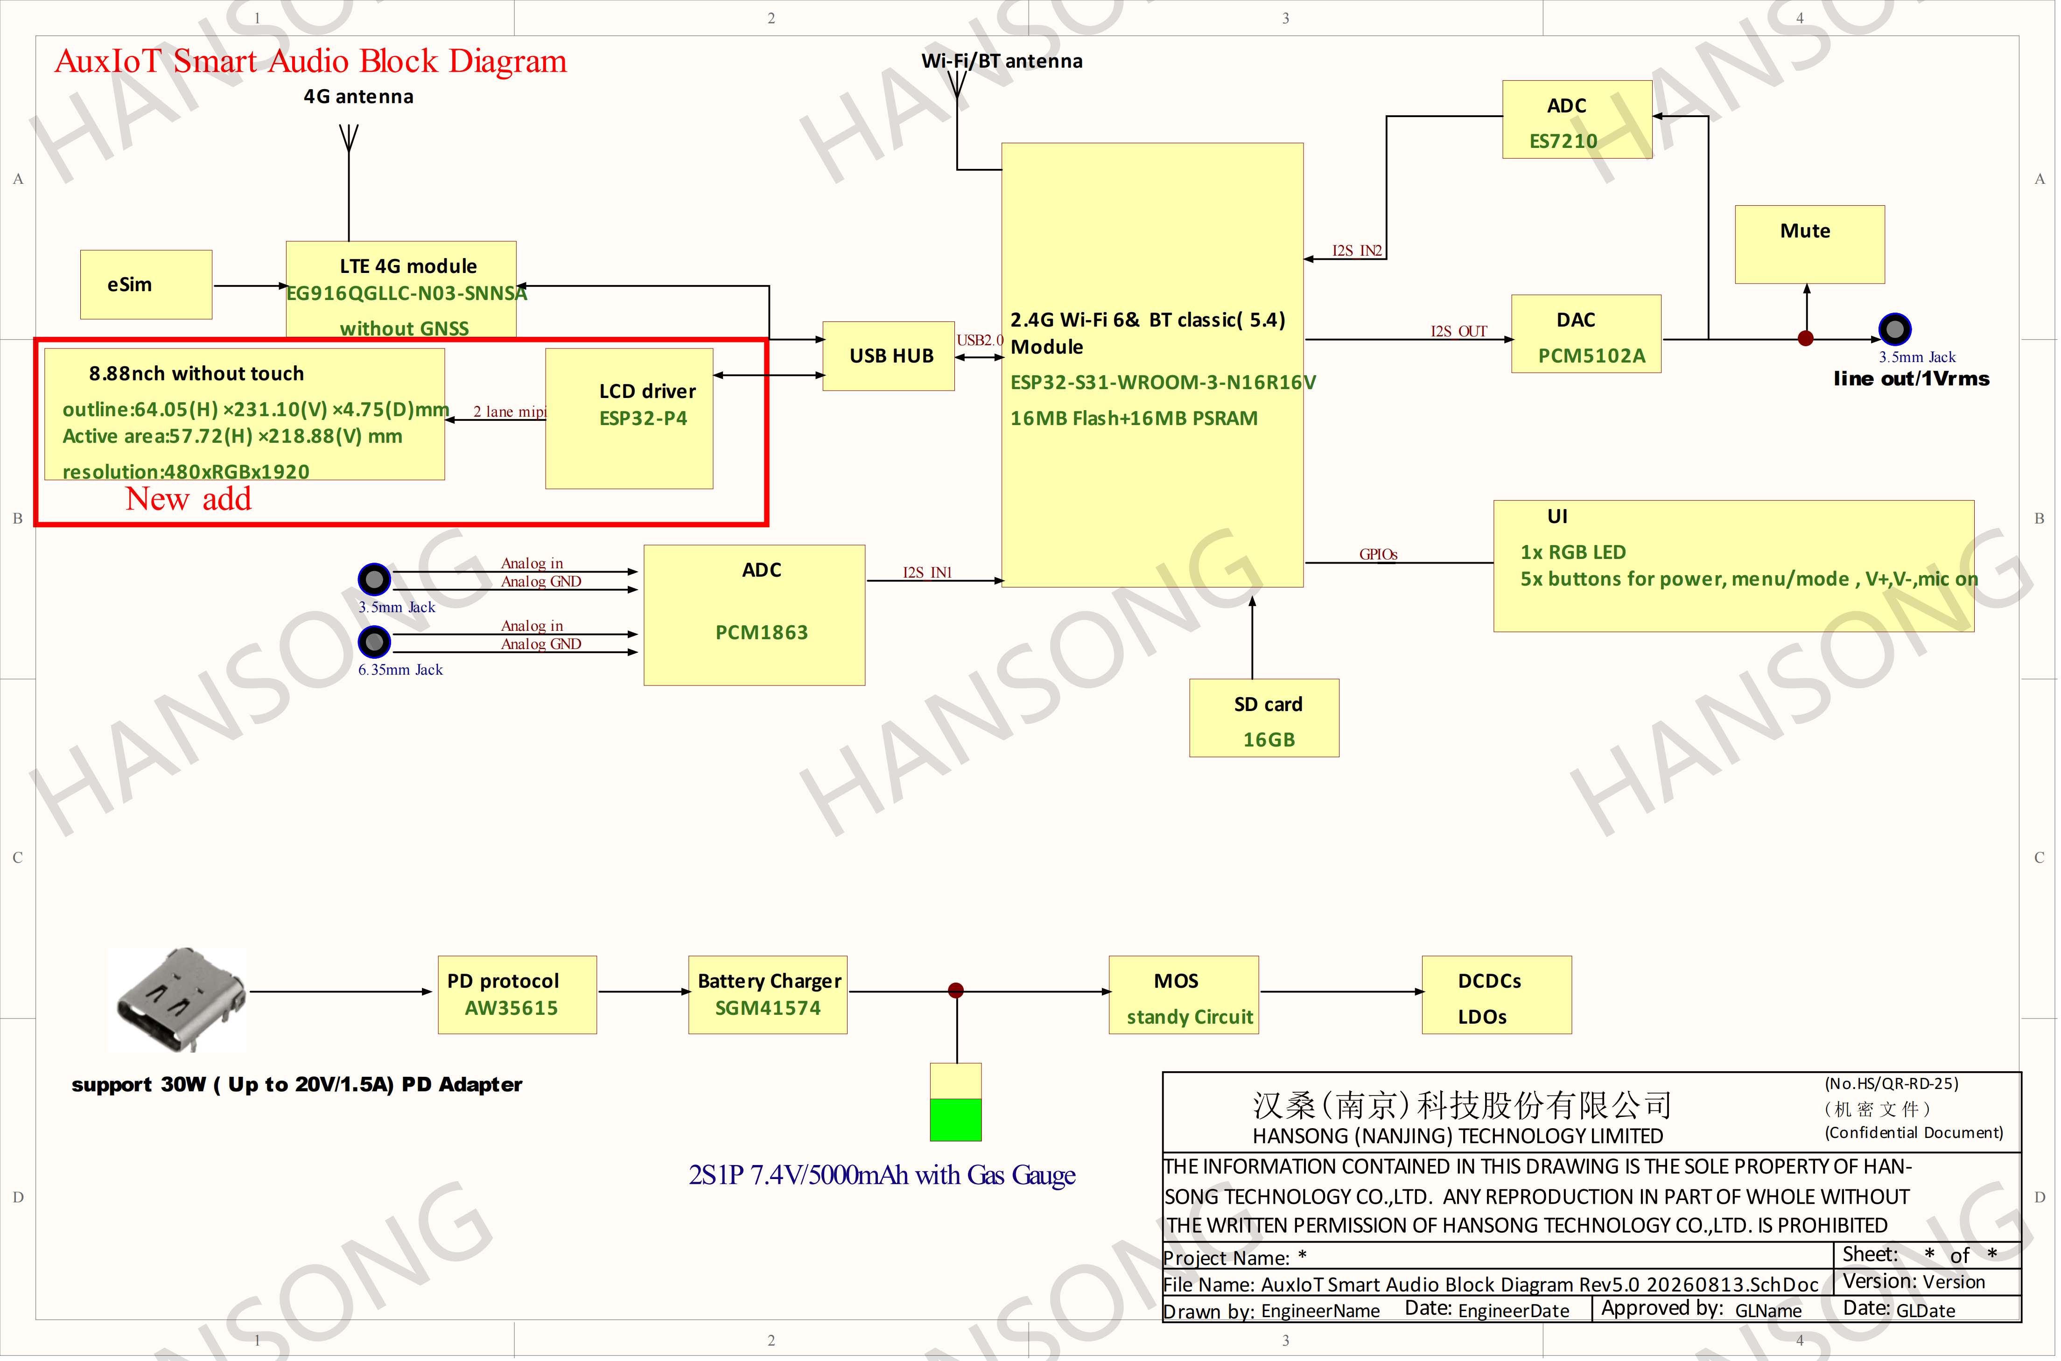
Block diagram

Slide 4
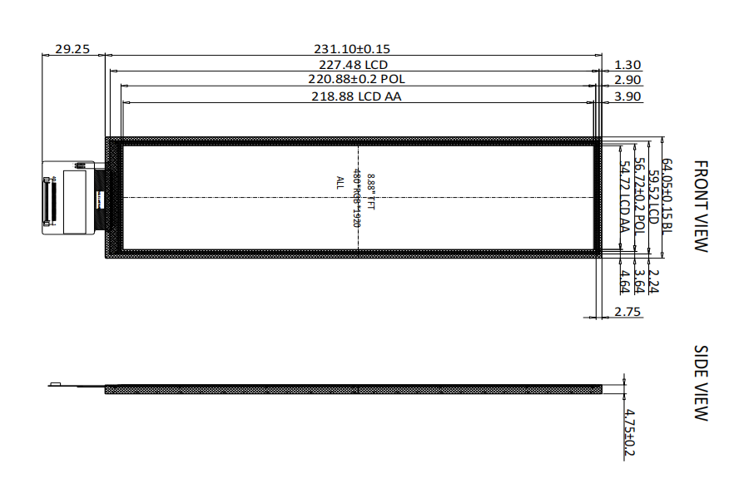
8.8 inch solution
8.8 inch TFT LCD without touch:
Active area:57.72(H) ×218.88(V) mm
resolution:480xRGBx1920
interface: 2-lane MIPI or 4-lane MIPI

Slide 5
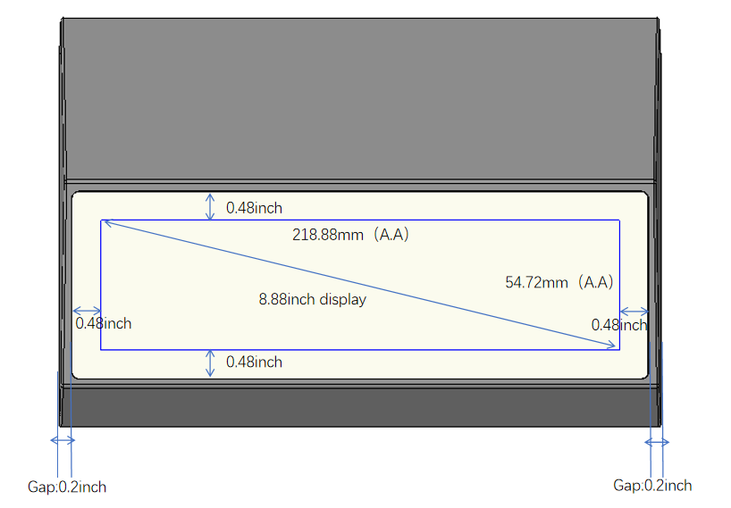
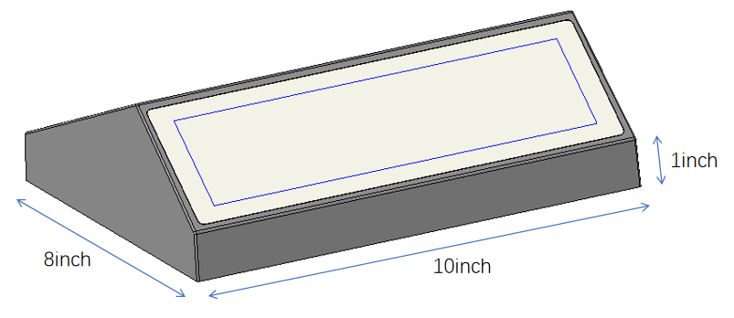
ME Spec.
ID dimension：W10inch*D8inch*H3.17inch

Slide 6
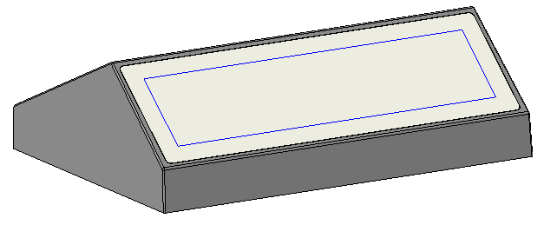
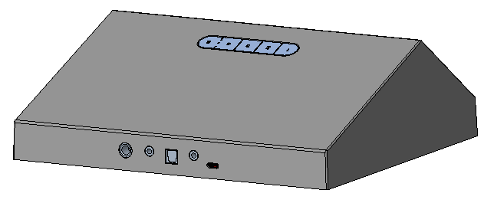
ME Spec.
display panel
C:transparent
M:glass
F:silk-screen
button
C:black
M:TPU
F:texture
top cover
C:black
M:ABS+PC
F:paint spraying, silk-screen
foot
C:black
M:rubber
F:NA
bottom cover
C:black
M:ABS+PC
F:paint spraying

